Slide 1
Corporate Bankruptcy prediction
Group Members
Akshay Ukarande.
Nandan Loya.
Jyoti Patil.
Vaishnavi Salunke.
Harsha Sapkale.
Guided By – Mr. Vikash Chandra.

Slide 2
Objective
Bankruptcy is a legal process through which people or other entities who cannot repay debts to creditors may seek relief from some or all of their debts.
Prediction of an enterprise bankruptcy is of great importance in economic decision making.
This is a classification project which contains two classes ‘Bankrupt’ and ‘Non-Bankrupt’
Prediction will be based on various econometric variables which are used to asses the fundamentals of corporate entity.

Slide 3
Business Understanding
Bankruptcy is a legal process through which people or other entities who cannot repay debts to creditors may seek relief from some or all of their debts.
Prediction of an enterprise bankruptcy is of great importance in economic decision making.
This is a classification project which contains two classes ‘Bankrupt’ and ‘Non-Bankrupt’
Prediction will be based on various econometric variables which are used to asses the fundamentals of corporate entity.
The dataset was taken from UCI platform.

Slide 4
Parameters | 1st year | 2nd year | 3rd year | 4th year | 5th year
Number of Rows | 7027 | 10173 | 10503 | 9792 | 5910
Bankrupt Rows | 271 | 400 | 495 | 515 | 410
Non-Bankrupt instances | 6758 | 9773 | 10008 | 9227 | 5500
Missing-Data Percentage | 54.54 % | 59.81 % | 53.48 % | 51.29 % | 48.71 %
Percentage of minority class samples | 3.85 % | 3.93 % | 4.71 % | 5.25 % | 6.93 %

Slide 5
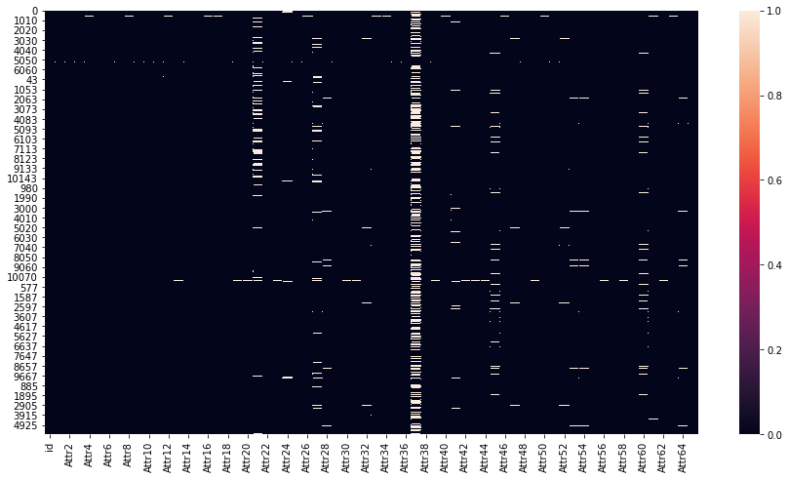
Missing Values
Null values are present in atr37(43.73%) and attribute 21(13.48%) (above 1000)
we can drop these columns as percentage of null values is high
Numeric methods of imputation can be used for other columns here as all the columns are numeric in nature

Slide 6
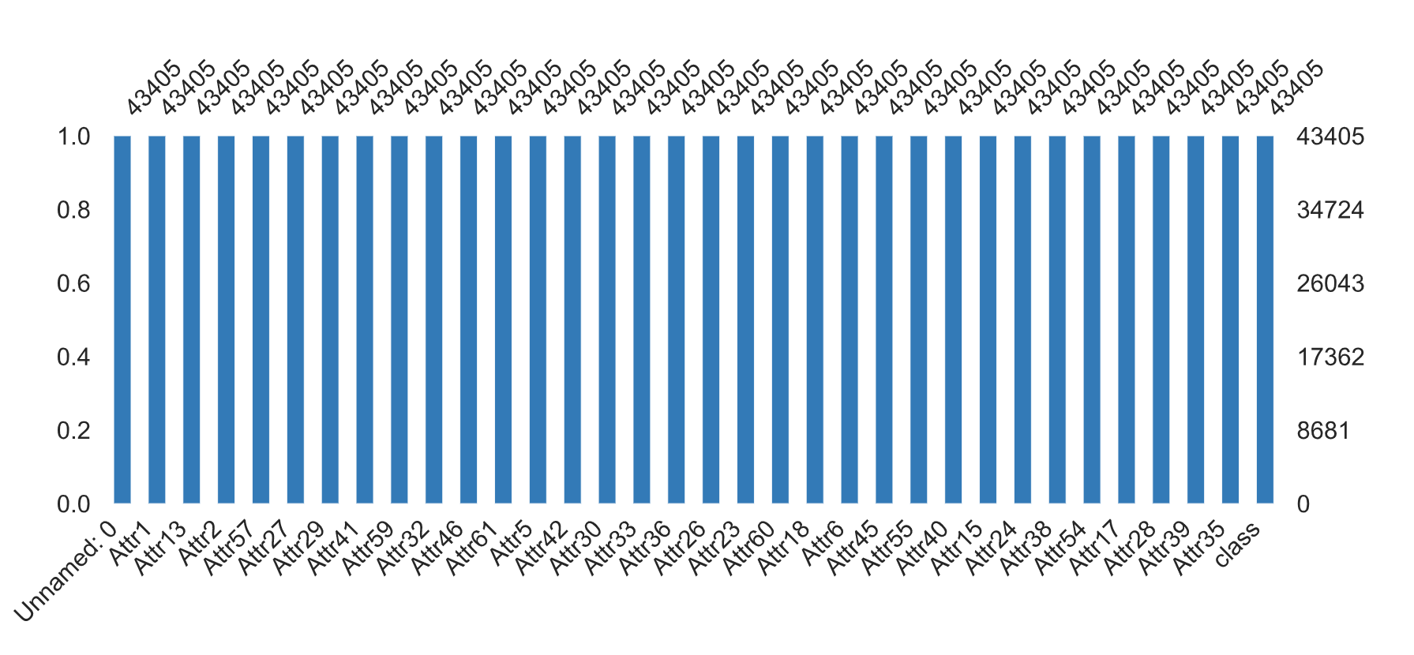
Handling Missing values
Mean Imputation: Replacing null values with mean values
KNN Imputation: Distance based Imputation
Linear Regression Imputation: Best Fit Line Imputation
MICE Imputation: Equation Based Imputation

Slide 7
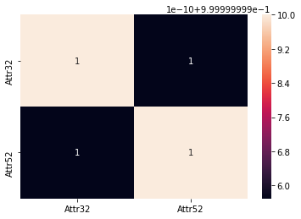
Statistics and Correlated Variables
We performed statistical tests to check following things :
Whether all imputations are executed correctly or not.
To find variables which contribute in prediction of target variable.
To check whether train test split of the data is correct or not.
Attribute 52 when multiplied by 365 , gives Attribute 32.
Due to this constant factor they are highly correlated.
X32 - (current liabilities * 365) / cost of products sold.
X52 - (short-term liabilities * 365) / cost of products sold).
Attribute | mean | std | min | max
Attr32 | 126.330 | 36.280 | 91.370 | 176.930
Attr52 | 0.346 | 0.099 | 0.250 | 0.484

Slide 8
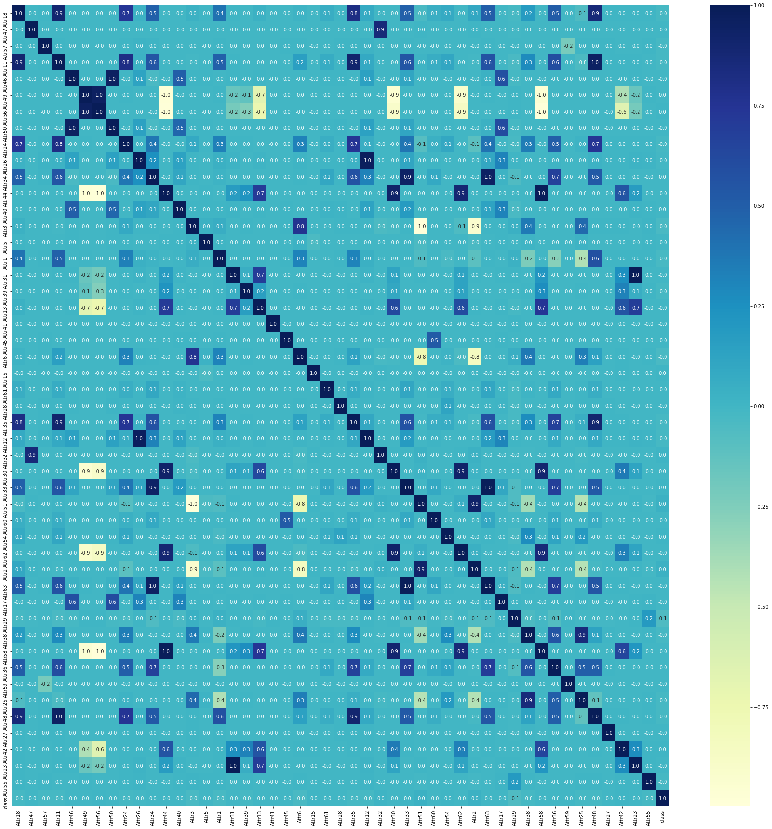
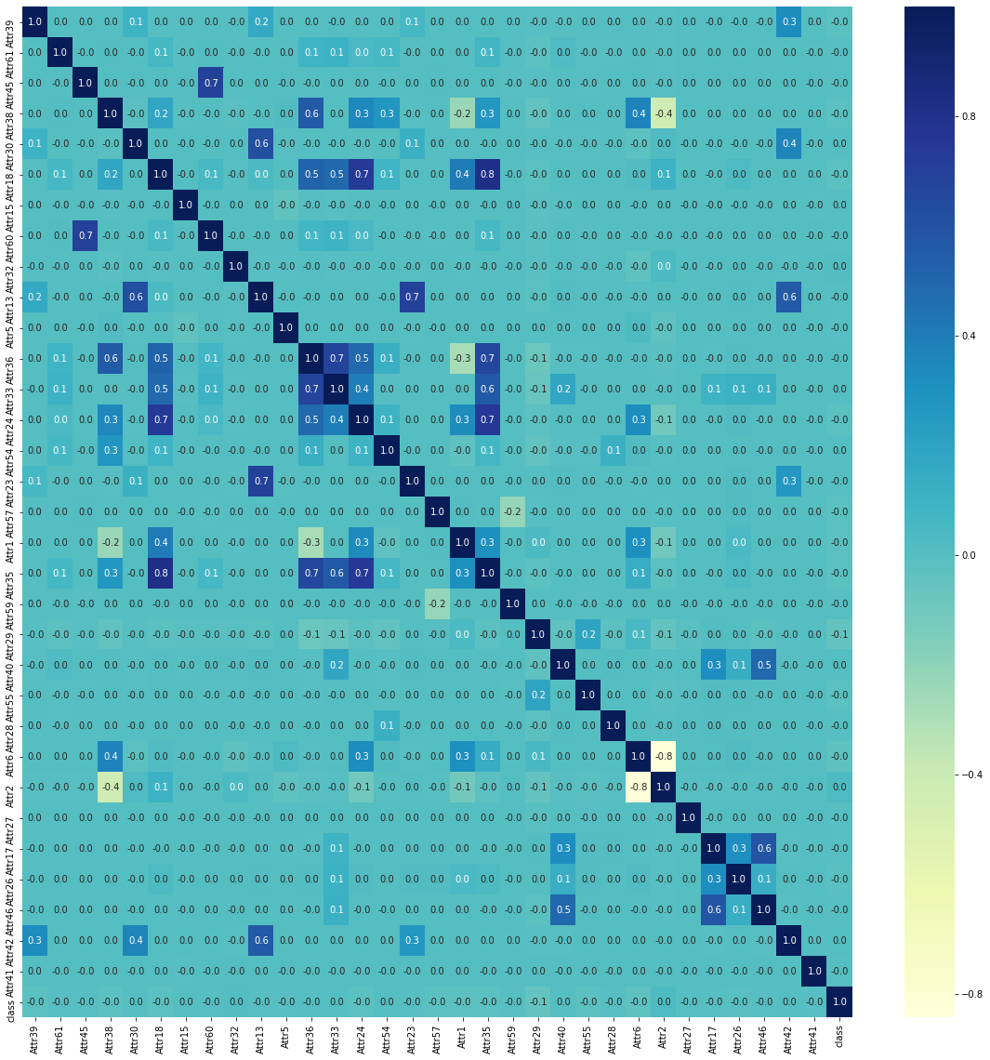
Feature Reduction
Those features which are highly correlated with other features are identified using heatmap and dropped from the data. After dropping highly correlated features we are left with 32 features.

Slide 9
Variance inflation factor
After dropping highly correlated features we are left with 32 features for base model building. For those 32 features we have calculated variance inflation factor to further check for multicollinearity. Only one variable has VIF higher than 10.
Features | VIF
Attr36 - total sales / total assets | 11.733411
Attr13 - (gross profit + depreciation) / sales | 5.784074
Attr6 - retained earnings / total assets | 5.699758

Slide 10
Machine Learning

Slide 11
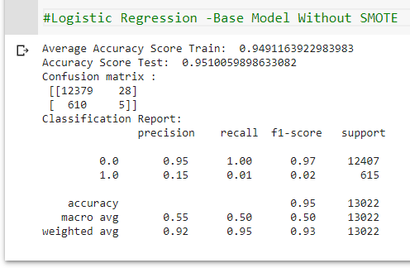
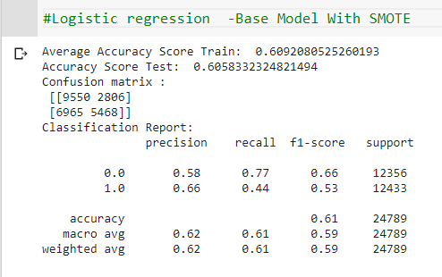
Base Models
Class labels were imbalanced:
95% -non bankrupt, 5% bankrupt.
Extremely Poor Performance in Predicting Class 1.
More Data for minority class was not available.
SMOTE and SMOTE Tomek was done.
Logistic regression as a base model was chosen as it is an industry proven algorithm but for this Dataset it didn’t classify the Labels correctly.
Ensemble and non-Linear models for further model building.

Slide 12
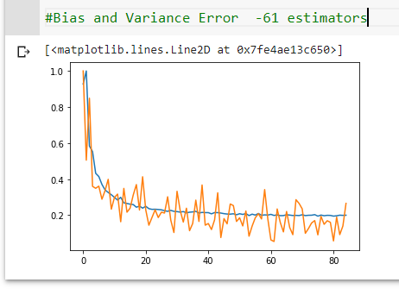
Hyper tunning Parameters
Random Forest
A Custom Search for finding optimum parameters
was done. Gridsearch was also done.
XGBoostClassifier
Similarly optimum Parameters were searched using GridsearchCV.
Learning rate(eta) in Xgboost:
- The Learning rate is the step size for a gradient curve.
- This parameter was regularized using a comprehensive gridsearch.
Hyperparameter tunning was done considering the model scores which resulted from
tunned parameters and parameters so chosen to maximize model performance.
Risk : Computational Power for higher iterations of Gridsearch.

Slide 13
Model Building
This was a comprehensive iterative and feedback loop based step.
Models were built keeping into mind the business problem – Of safeguarding the Creditors from bankrupting Companies.
For this every model metric was evaluated and the focus more was on reducing/Minimizing the False Negatives (type II error).
Type II error : A Company been labelled as “Not Bankrupt” (0) where in actually the company is “Bankrupt” (1).
Vice Versa type I error can also have bad implications on a company but that not being the motive, type II error was more focused.

Slide 14
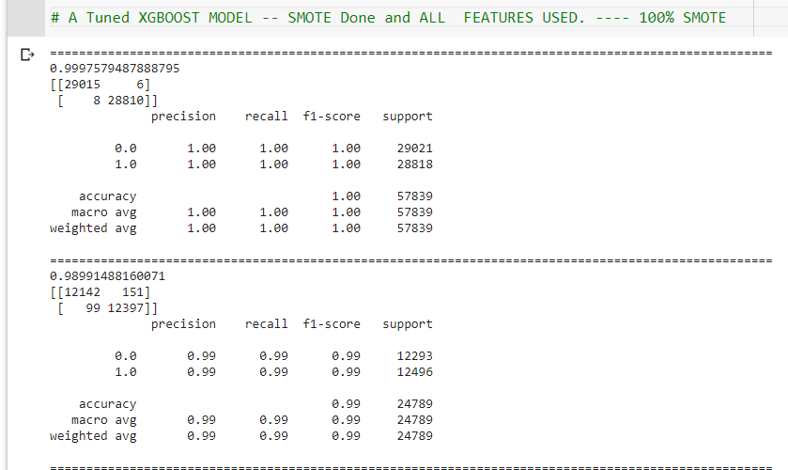
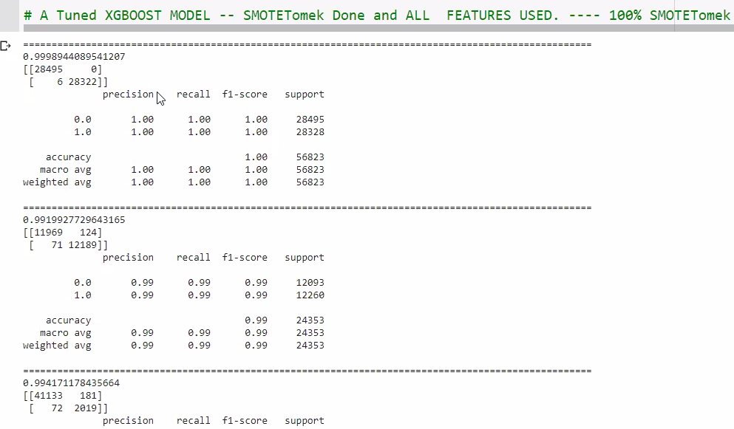
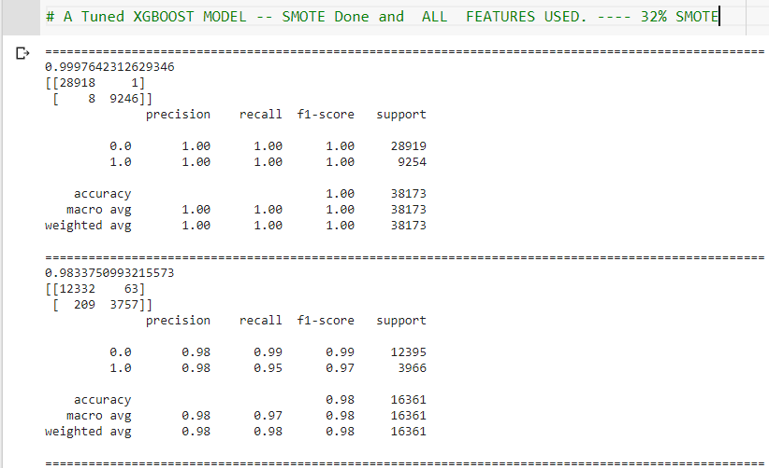
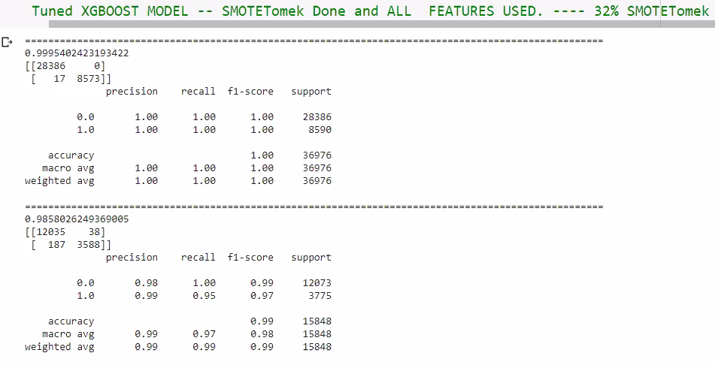
XGBOOST CLASSIFIER TUNNED MODEL ITERATIONS
Train
Train
Train
Test
Test
Test
Train
Train
Test
Test

Slide 15
Models with 32 features
The models are created on those 32 features which are contributing in prediction of target column and which don’t have multicollinearity in-between them.
Sr. No. | Model | Training Accuracy | Testing Accuracy | Training Accuracy After Tuning | Testing Accuracy After Tuning | Remarks
1. | Decision Tree Classifier | 100% | 92.32% | 99.99% | 92.69% | Overfit Model
2. | Random Forest Model | 100% | 97.60% | 99.99% | 97.50% | Good Model
3. | Logistic Regression Model | 61.22% | 62.04% | NA | NA | Underfit Model
4. | Ada-Boost Model | 83.57% | 83.95% | NA | NA | Underfit Model
5. | Gradient Boosting Model | 89.48% | 89.39% | NA | NA | Underfit Model
6. | XGB Classifier | 100% | 98.24% | 99.30% | 97.87% | Good Model

Slide 16
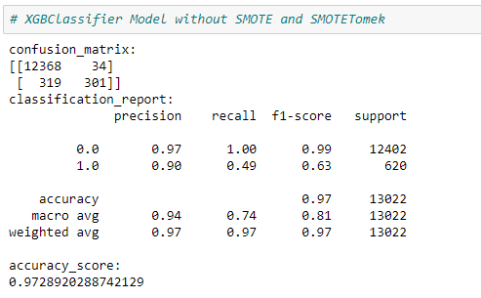
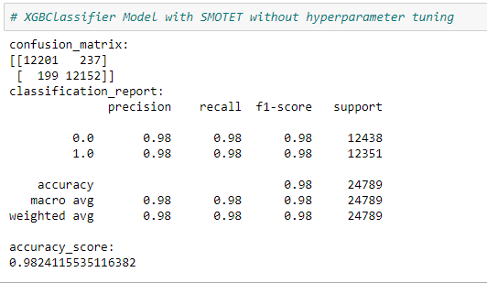
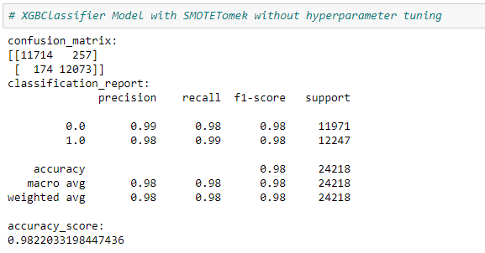
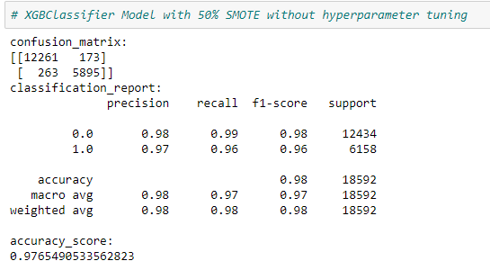

Slide 17
Basic Decision Tree Model
Feature | Importance | Description
Attr6 | 0.184741 | retained earnings / total assets
Attr27 | 0.179486 | profit on operating activities / financial expenses
Attr26 | 0.062767 | (net profit + depreciation) / total liabilities
Attr46 | 0.060116 | (current assets - inventory) / short-term liabilities
Attr29 | 0.056575 | logarithm of total assets
Basic Random Forest Model
Feature | Importance | Description
Attr27 | 0.158507 | profit on operating activities / financial expenses
Attr6 | 0.084488 | retained earnings / total assets
Attr24 | 0.050928 | gross profit (in 3 years) / total assets
Attr26 | 0.044817 | (net profit + depreciation) / total liabilities
Attr46 | 0.044298 | (current assets - inventory) / short-term liabilities
XGB-Classifier
Feature | Importance | Description
Attr6 | 0.144509 | retained earnings / total assets
Attr27 | 0.103829 | profit on operating activities / financial expenses
Attr26 | 0.096343 | (net profit + depreciation) / total liabilities
Attr39 | 0.052176 | profit on sales / sales
Attr59 | 0.044391 | long-term liabilities / equity

Slide 18
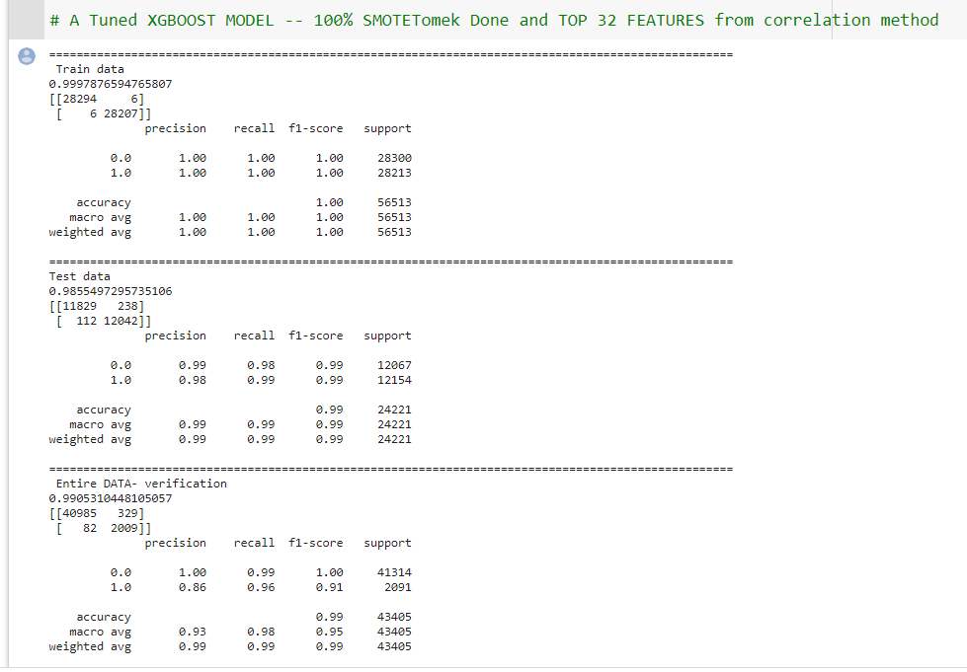
Final Model
This Model has overall good performance
The model is not facing any under-fitting or over-fitting issue.
As we can see all the parameters precision, recall ,
f1-score and accuracy are better than all other
models.
Though some corporate entities are falsely being classified as Bankrupt still from a business point of view of creditors, it is not a threat. From creditors point of view classifying probable bankrupt company as non-Bankrupt is a bigger threat.

Slide 19
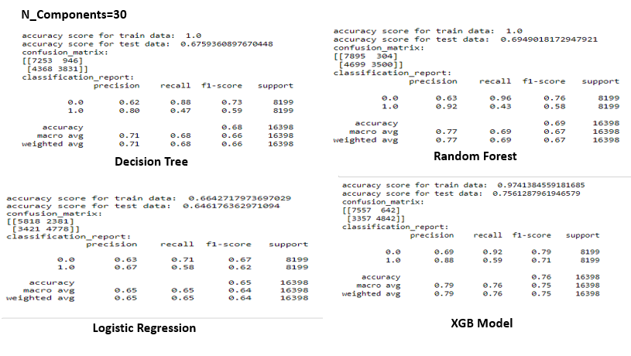
Principle Component Analysis
Number of Components: 30
Variance coverage :98.5%
Overfitting Observed.

Slide 20
Key risk and Way Forward
Computational limitation
It is possible to synthesize more features considering the current synthetic features as base features (Feature Engineering)
Also we observe many clusters of the data when we apply Kmeans clustering , indicating that the dataset is not uniform and these companies come from different backgrounds.

Slide 21
Thank You

Slide 22
Appendix

Slide 23
About the data
Data is divided in 5 different parts representing prediction cycle for different years.
The bankrupt companies were analyzed in the period 2000-2012, while the still operating companies were evaluated from 2007 to 2013.
There in total 64 econometric attributes in dataset.
These attributes are basically ratios between different financial indicators
For example, Higher Assets as a financial indicator signifies that the corporate entity is in strong position whereas higher Liabilities indicate the risky position of an entity, liabilities are basically debts that the company owes to the creditors.
There are various operations that need to be done on data before any model is built.

Slide 24
Data Pre Processing
Conversion from ‘.arff’ format to ‘.csv’.
Loading the dataset with pandas library
Nan values were in form of ‘?’. These were changed to np.nan
‘Object’ datatype changed to ‘Numeric’ one.

Slide 25
By Imputation methods Missing values were handled.

Slide 26
32 Features

Slide 27
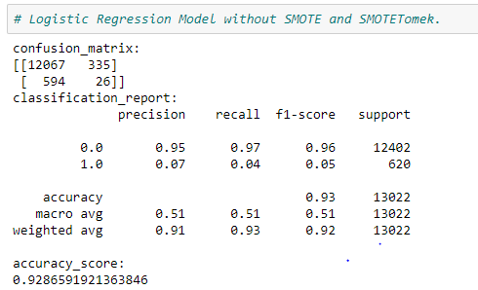
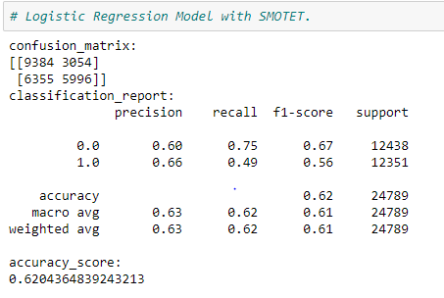
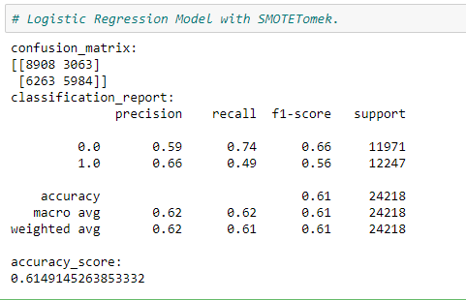

Slide 28
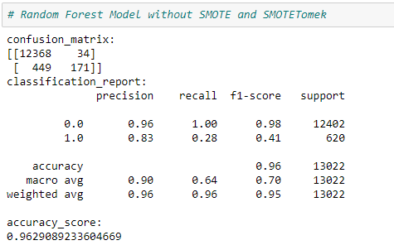
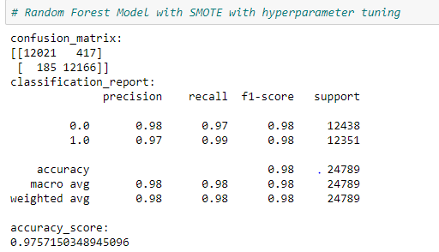
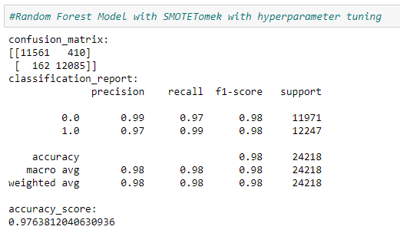

Slide 29
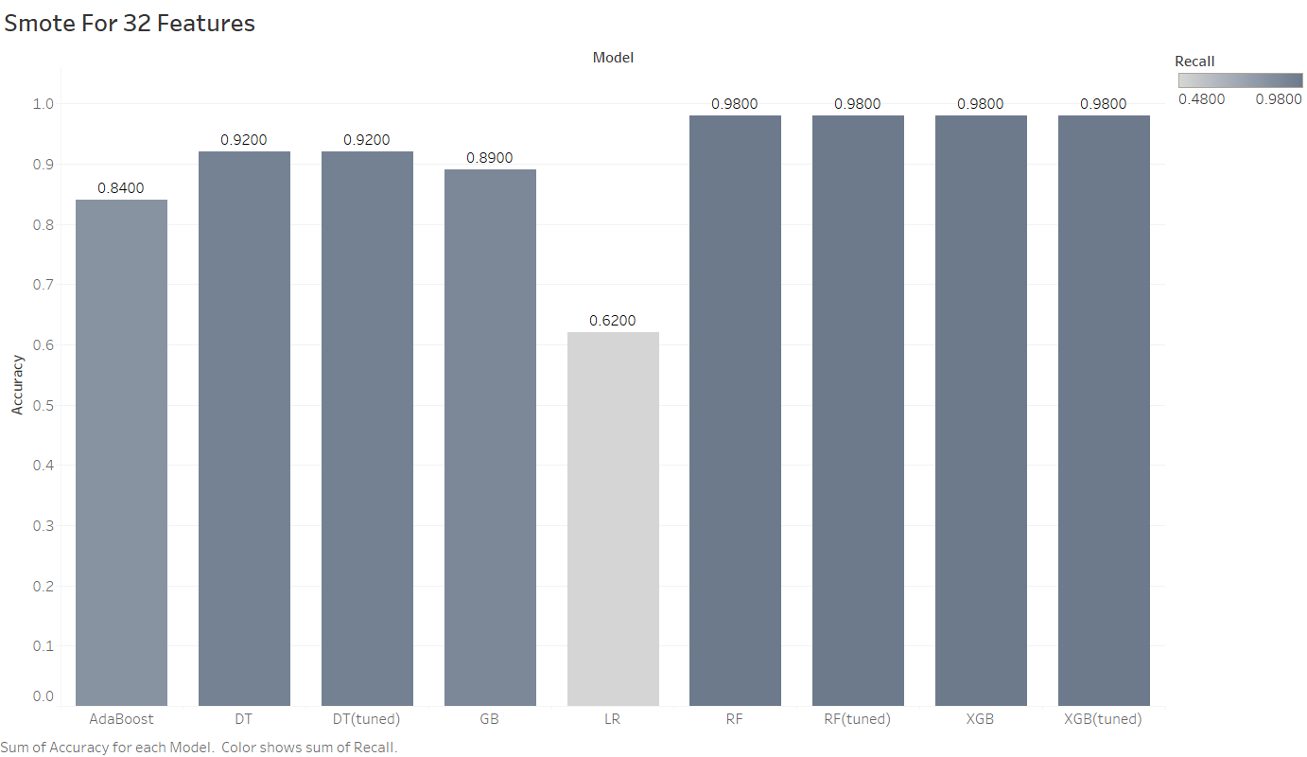

Slide 30
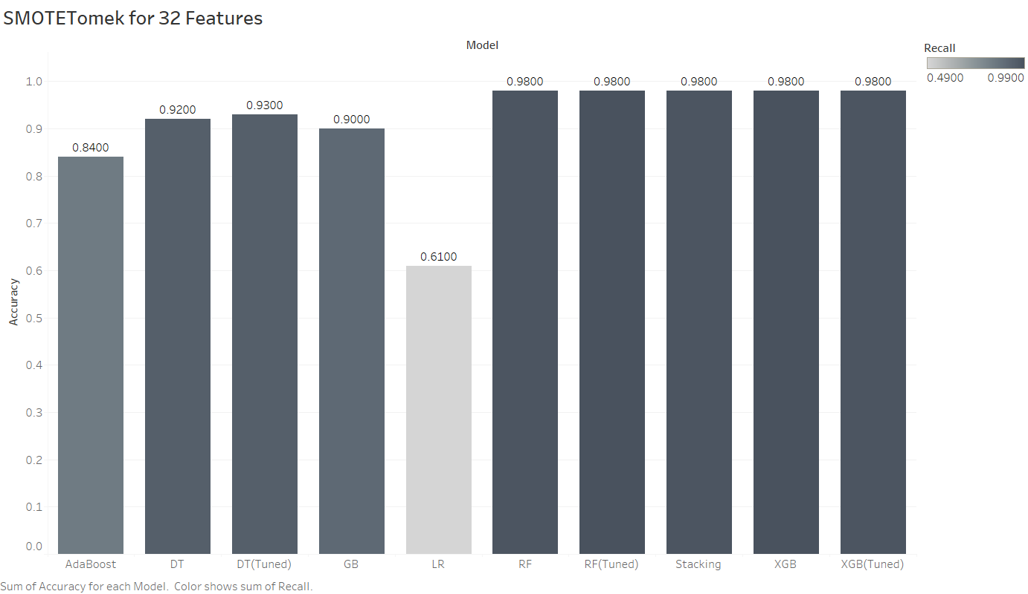

Slide 31
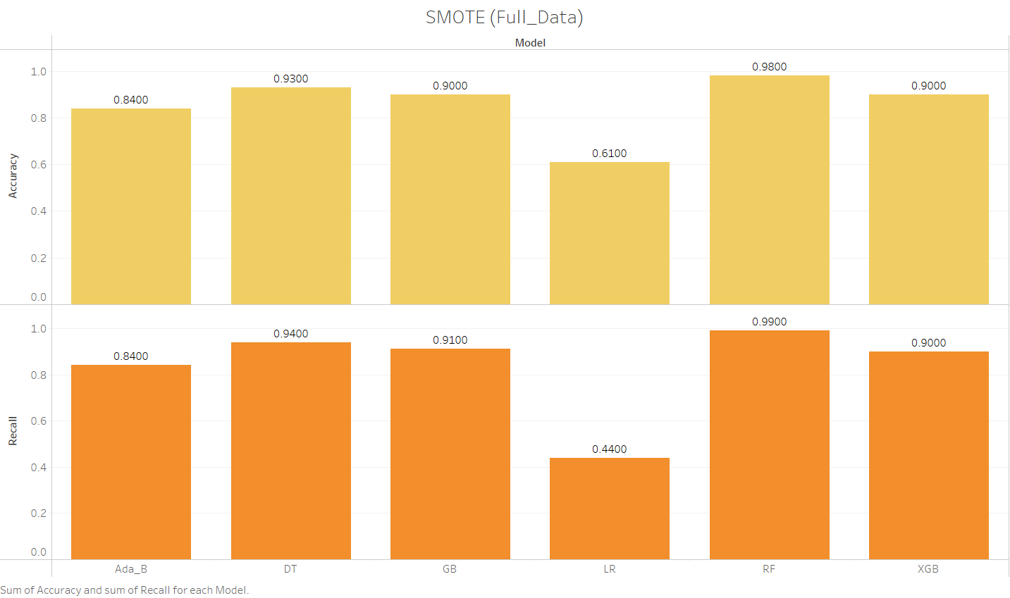

Slide 32
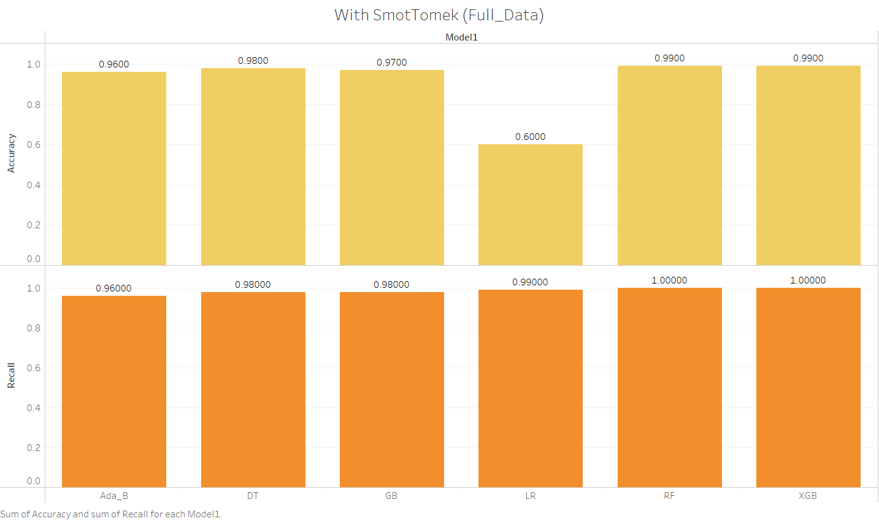

Slide 33
Model Building

Slide 34
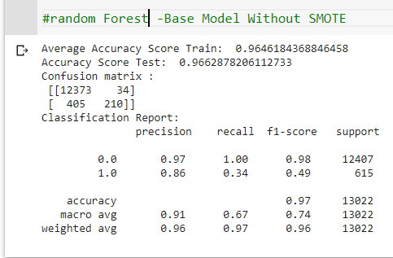
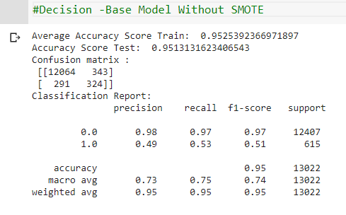
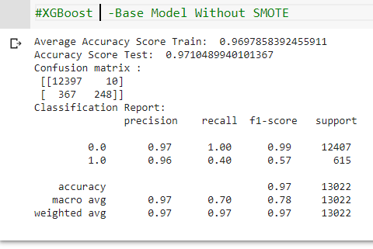
Base Models without Smote

Slide 35
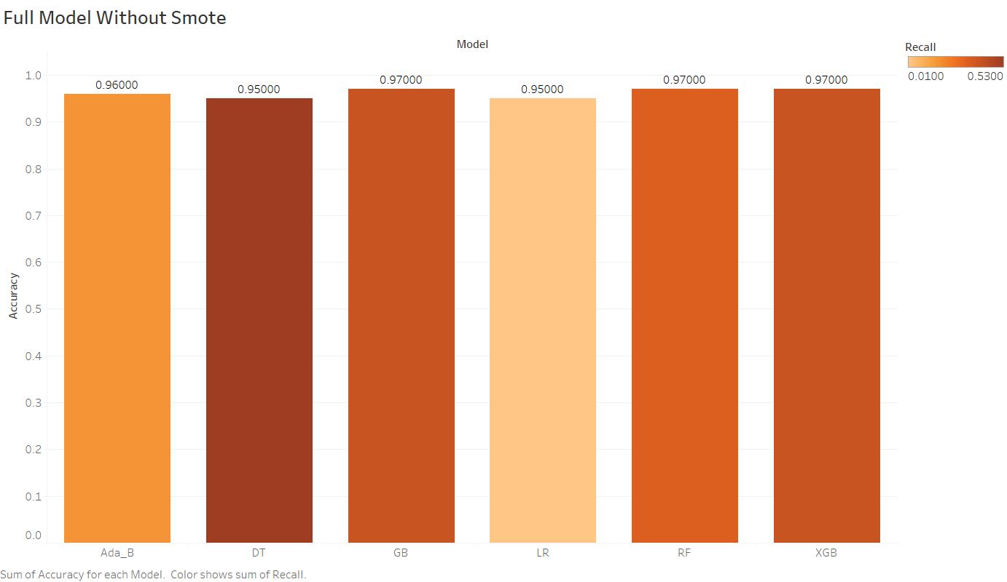

Slide 36
Random Forest
Different accuracy score for each imputed data frame(df1,df2,df3,df4,,df5)
Logistic Regression
KNN Classifier
May change according to condition.
Raw Data(csv format)
With null values
df1,df2,df3,df4,df5
KNN imputation
Mean Imputation
Any Other imputation
Smote on Imputed Data
To handle null values
Arff to csv conversion done before loading dataset
Also can add other Algorithms according to condition.

Slide 37
SMOTE
Synthetic Minority Oversampling Technique
Class labels were imbalanced: 95% -non bankrupt, 5% bankrupt
Using Smote technique Balance after train test split on combined dataset with all attributes.
Train
Before SMOTE Counter({0.0: 33047, 1.0: 1677})
After SMOTE Counter({0.0: 33047, 1.0: 33047})
Test
Before SMOTE Counter({0.0: 8267, 1.0: 414})
After SMOTE Counter({0.0: 8267, 1.0: 8267})

Slide 38
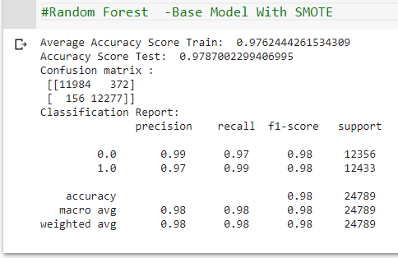
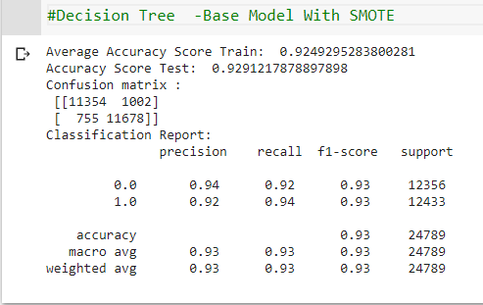
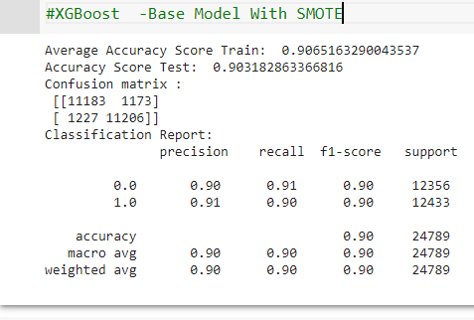
Base Models with Smote

Slide 39
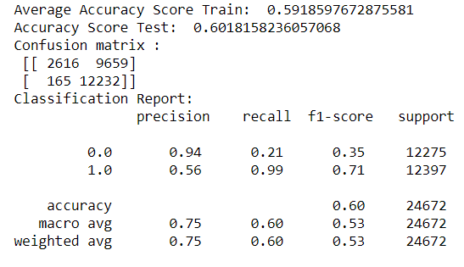
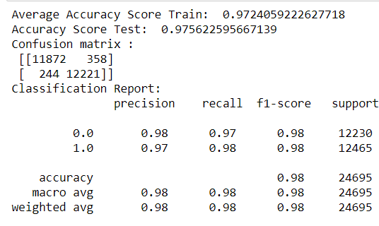
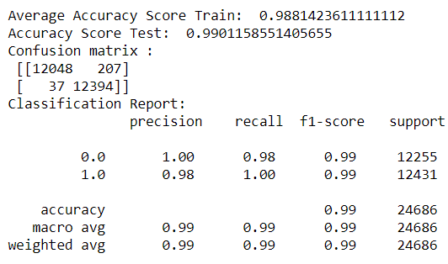
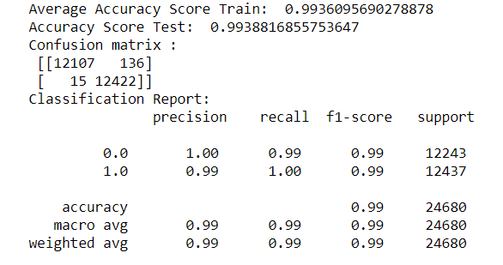
Base Models with SmoteTomeks
Logistic Regression
Decision Tree
Random Forest
XGBoost

Slide 40
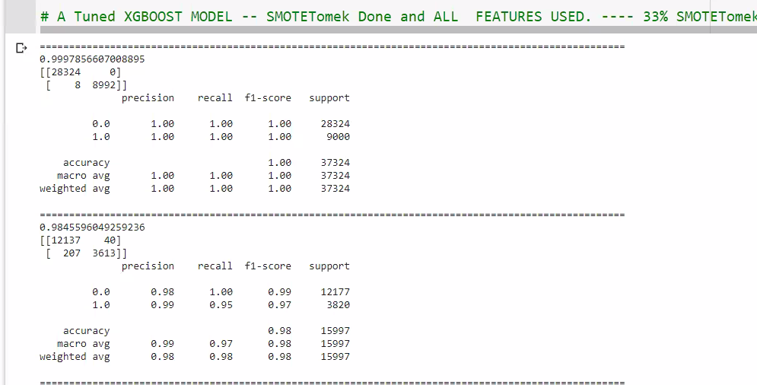
Tunned models

Slide 41
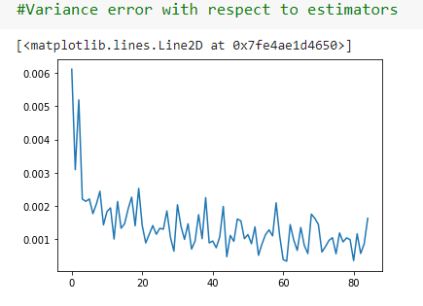
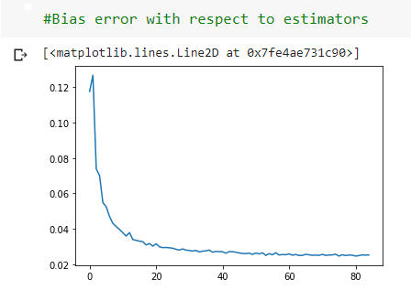
Hyper tunning Parameters
Random Forest

Slide 42
XGBoost Classifier
Similarly optimum Parameters were searched using GridsearchCV.
Learning rate(eta) in Xgboost:
- The Learning rate is the step size for a gradient curve.
- This parameter was regularized using a comprehensive gridsearch.
Hyperparameter tunning was done considering the model scores which resulted from tunned parameters and parameters so chosen to maximize model performance.
Risk : Computational Power for higher iterations of Gridsearch.

Slide 43
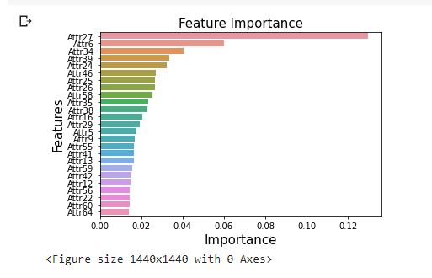
Feature Selection
Using random forest feature importance

Slide 44
Model Building with Hyperparameter tuning
This was a comprehensive iterative and feedback loop based step.
Models were built keeping into mind the business problem – Of safeguarding the Creditors from bankrupting Companies.
For this every model metric was evaluated and the focus more was on reducing/Minimizing the False Negatives (type II error).
Type II error : A Company been labelled as “Not Bankrupt” (0) where in actually the company is “Bankrupt” (1).
Vice Versa type I error can also have bad implications on a company but that not being the motive, type II error was more focused.

Slide 45
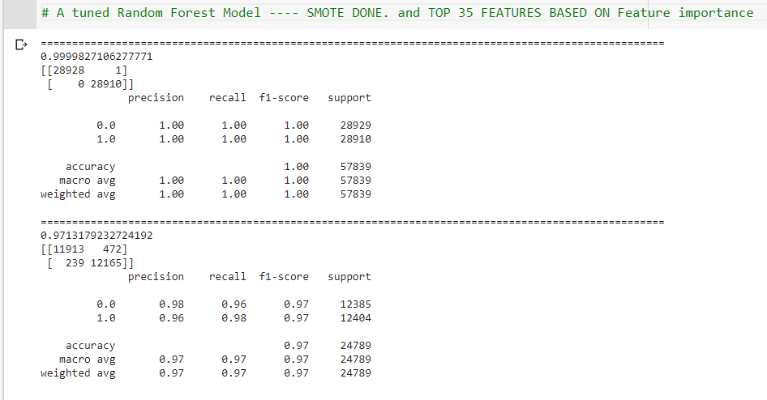
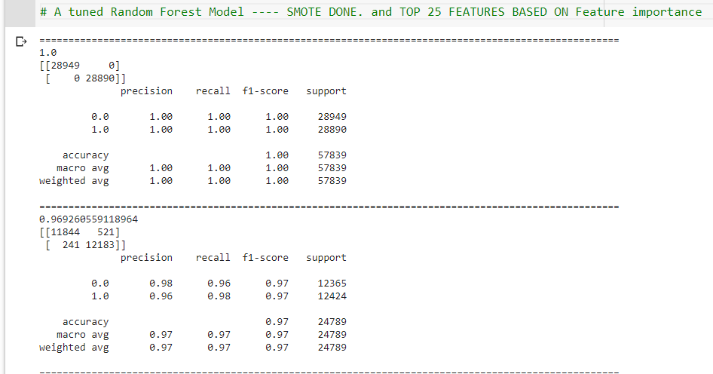
RANDOM FOREST TUNNED MODEL ITERATIONS
Train
Train
Test
Test

Slide 46
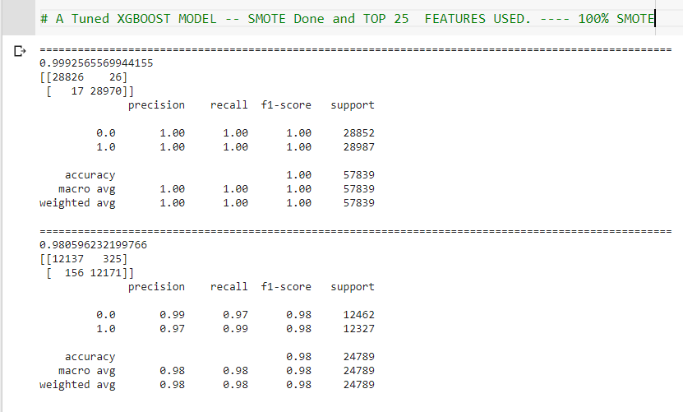
XGBOOST CLASSIFIER TUNNED MODEL ITERATIONS
Train
Train
Test
Test
Train
Test

Slide 47
PCA

Slide 48
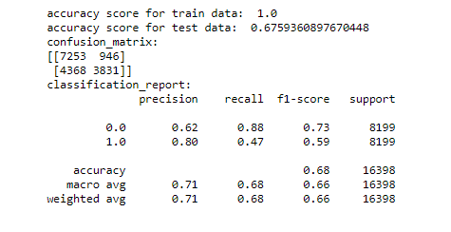
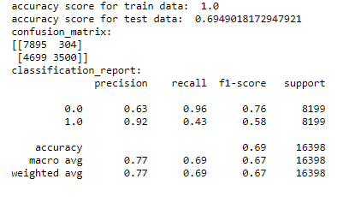
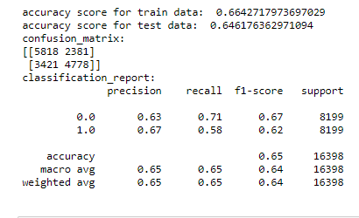
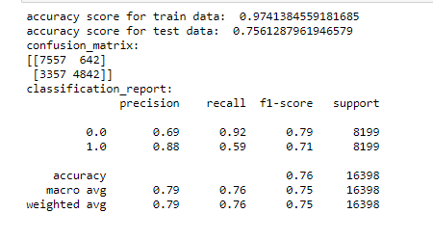
PCA with smote Tomek with scaling
N_Components=30
Decision Tree
Random Forest
Logistic Regression
XGB Model

Slide 49


Slide 50
PCA is also a method of reducing the dimensionality of the data.
Unlike removal by variance inflation factor PCA creates its own components which individually cover some percentage of variance in the data.
With scaling we get 98.5% variance coverage for 30 components.
Model built on these components performs very poorly on test data leading to the issue of overfitting.
Also False Negative percentage is very high for these classifications
For unscaled data 99% variance coverage observed for 10 components.

Slide 51




PCA smote Tomek without Scaling
Decision Tree
Random Forest
Logistic Regression
XGB Boost

Slide 52


Slide 53

Inertia
Number of Clusters

